Slide 1
Biomechanics
Week9

Slide 2
Learning Objectives
Content includes:
application of biomechanical principles to improve the quality of movement.
simple understanding of how force is produced and how force is absorbed by equipment used, and how force is provided and absorbed by the body

Slide 3
Application of biomechanics
Knowledge of biomechanics can improve performance and prevent sports injuries by
Helping coaches make modifications based on the athletes body shape, in order to improve performance
Providing guidelines for the selection of appropriate equipment to suit an individuals body size and shape in order to achieve optimal performance
Reducing the incidence of overuse or impact injuries by promoting an understanding of the force absorption requirements of specific skills.

Slide 4
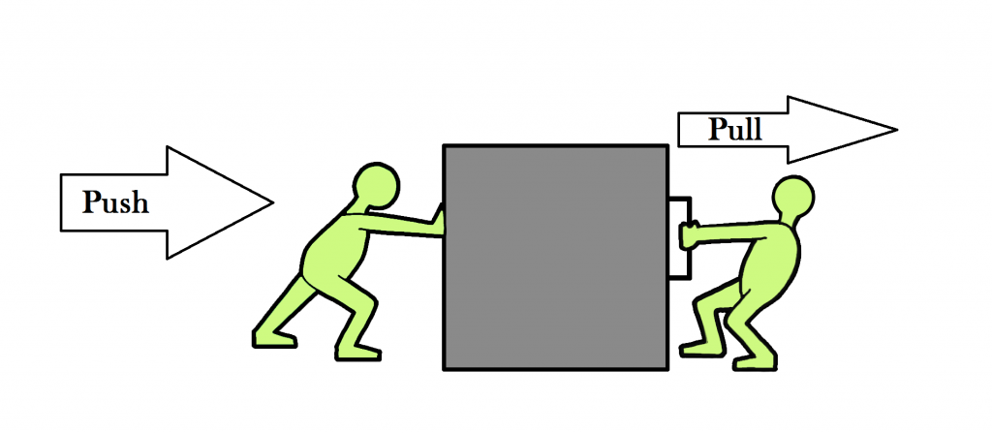
What is Force?
Force is a pushing or pulling action that changes a body’s state of motion.
Gaugers Pg. 205

Slide 5
Types of force
Through application of force, a body at rest can be made to move, or a body in motion can be slowed, stopped or have its speed increased, or direction of motion changed.
Internal Forces
Are generated by the action of muscles on the skeletal system
Example: the contraction of the quadriceps muscle groups to extend the leg when kicking a football
External Forces
Are generated outside the body and act on it in some way.
Example: Gravity, friction. Air resistance and water resistance.

Slide 6
Applied Forces
Isometric Force
Isotonic Force
Maximal
Submaximal

Slide 7
Applied Forces
Applied forces are those generated by the action of muscles and applied to surface as in the case of a running track, or to objects, such as a ball or barbell.
Applied forces can be classified as either isometric or isotonic based on the effect of the force on the body.

Slide 8
Applied Forces
Isometric
When the length of the muscle does not change during muscular contraction to apply force.
Example: pushing against a wall

Slide 9
Applied Forces
Isotonic
When applied force is sufficient to change the motion of an object.
Example: passing a ball or pushing off a starting block for a swim start.
Maximal
Maximum contraction by the muscles involved to produce an all-out effort.
Example: High jump, throwing a javelin, 100m sprint
In order to achieve maximal force, perfect timing and technique are also important contributing factors.
Submaximal
Graduated muscle contraction to achieve a controlled movement
Example: receiving a pass in basketball, a set in volleyball
Such skills require the performer to apply just the correct amount of submaximal force to achieve optimal performance.

Slide 10
Power
In order to run faster or jump higher, we need to develop power.
This can be achieved by either increasing strength (force) or the speed at which muscles contract.
For runners and jumpers, the speed of contraction is of greater importance, while for weightlifters, the strength element is more crucial.
By identifying the specific requirement of an activity, it is possible for an athlete to develop the more appropriate form of power.

Slide 11
Reaction forces
When any force is applied, a similar force opposes it from outside the body. This is known as reaction force.
An example of applied and reaction force is the athlete being propelled along the track due to the applied force generated by the leg muscle is being equally matched by the reaction force coming from the track surface. If the applied force is increased, this is matched by the reaction force and results in an increased in running speed.
Newtons 3rd law- every action has an equal and opposite reaction.

Slide 12
Application of force
Force can also be applied to objects such as balls, javelins and weights.
There are two main principles to consider which are acceleration and mass
It is important to be able to control the amount of force applied to an object, for example, putt in golf.
Acceleration
The greater the force applied, the greater the acceleration of the object
Example: The harder a ball is hit or kicked, the faster it will travel and greater the distance it will cover.
Mass
The greater the mass of an object, the greater the force required to move it.
Example: a 20kg dumbbell requires more force to be exerted by the muscle in order to lift it, than does a 10kg dumbbell.

Slide 13
The absorption of force
Forces exerted by the body are absorbed through joints, which bend or flex in response to the impact. The the body lands on the floor or similar surface, it exerts a force on the surface which, in response, exerts a matching force on the body.
If the knees are not bent to allow for a slow, controlled dissipation of the forces by the muscles, then the risk of injury to the joints and surrounding tissues is greatly increased.

Slide 14
Example
Example: Catching a fast moving ball
The force needs to be absorbed to prevent injury
The force of the ball cannot change, the only way to reduce impact is to increase distance through which the hands move to catch the ball to help absorb force.
https://www.youtube.com/watch?v=PAdNdh6R9IE

Slide 15
Coin Activity
Aim: To apply force by flicking the coin to try and have it land on the edge of the opposite side of the table, when it does you need to flick it up and catch it to win a point.
Rules:
Start with the coin on your side of the table on the edge
Take it in turns.
If you flick the coin up and don’t catch, no point. Start again
If you apply to much force and your coin goes off the table, start again.

Slide 16
Application of force Activity 2
Page 104
Go to Kingsbury park
Complete activity
Tennis balls
Basketballs
Medicine ball
Tape measure

Slide 17
Activity – Absorption of forces
Page 106
Phone to record movement
Water balloons

